Slide 1
Faculty Senate Meeting
June 1, 2023

Slide 2
Meeting procedure
Only Senators may debate motions
Only Senators can vote
If you are not a Senator, or a proxy, you cannot vote or debate
Do not speak over someone, or out of order
  Raise your hand to speak
  The President may call on you and then you will have the floor
Unless you have been recognized (been told you have the floor), you may not speak

Slide 3
Meeting Minutes
We will be using Robert's Rules to guide our recording of minutes.
Robert's Rules of Order say that meeting minutes are simply a summary of what happened at the meeting.
They are not a play by play of everything that happened or what members said.
If needed, Faculty Senators may request access to the audio recording of the meeting. Please email facsenate@mst.edu with justification.

Slide 4
Agenda
Call to Order and Roll Call
D. Westenberg, Secretary

Slide 5
Agenda
Approval of Minutes
April 27, 2023

Slide 6
Agenda
III. President’s Report
K. Sheppard

Slide 7
President’s Report

Slide 8
Campus Matters:
Faculty and Staff Climate survey report
Tenure Policy Committee—things ended on a good note. Moving toward getting everyone to read all the dossiers.
Bylaws
  Issue with versions
  Re-voting on them in the June 29 meeting
Library Dean Search

Slide 9
Campus Matters:
Get your departments to vote for senators for 2023-2025 terms. If you were elected in 2022, you’re serving for another year.
Candidates needed by June 16. One from each department
  Grievance Hearing Panel
  Equity Resolution

Slide 10
IFC Stuff:
Mark Fitch will tell you, I think, that that state budget stuff looks “healthy” for next year
Discussion of AI/ChatGPT
SBs didn’t pass: 473 and 410
  BoC refused request for definitions of issues at hand
NTT promotion issue here at S&T
Notes:
Senate Bill 473: ending special status
Senate Bill 410: “Do no harm”
Critical Race Theory bill: right now for K-12

Slide 11

Campus Matters:
What worked and what didn’t: Faculty Senate edition
  Meeting speed and efficiency:
  Questions for Administrators:
  Attendance at Gen Fac (for Admin reports):
Notes:
Next year: move away from reports and instead do short reports about issues.

Slide 12
Campus Matters:
What worked and what didn’t: Faculty Senate edition
  Debate/discussion of issues:
  Special guests (when invited):
  Times I could use my gavel:

Slide 13
Questions?

Slide 14
Agenda
IV. Campus Reports
  A. Staff Council
  M. Fowler
  (No report)

Slide 15
Agenda
IV. Campus Reports
  B. Student Council
  S. Young
  (No report)

Slide 16
Agenda
IV. Campus Reports
  C. Council of Graduate Students
  M. Twarakavi
  (No report)

Slide 17
Agenda
V. Special Topics
Direct Admissions
S. Raper

Slide 18
Agenda
VI. Reports of Standing Committees
A. Academic Freedom and Standards
E. Park

Slide 19
Retroactive Withdrawal Policy
Academic Freedom and Standards Committee
Presentation to Faculty Senate
June 1, 2023

Slide 20
Referral
Given the increase in mental health concerns and other concerns about grades, the Interim Associate Provost for Academic Operations, Accreditation, and Assessment and the Registrar believe that S&T should consider establishing a standing committee to deal with the revision of student records.
The AF&S committee was asked to look into the possibility of establishing a standing committee similar to Mizzou’s Revision of Student Records Standing Committee, which is responsible for acting on petitions for revisions to entries concerning grades and credits in the official academic record.

Slide 21
AF&S Committee’s Take on the Issue
At Mizzou, an instructor cannot change a letter grade to “W” unless a withdrawal has been approved. The main function of the Mizzou's committee is to determine that a student be allowed to retroactively withdraw from a course.
There are general guidelines and process that the Mizzou’s committee must follow.
https://committees.missouri.edu/revision-of-student-records/
The AF&S committee feels that their (or any other such committee) process cannot avoid inherent difficulties and biases, and does not support the establishment of a standing committee to deal with the revision of student records at S&T.

Slide 22
Concerns about the Effectiveness of Such a Committee
There are many factors that can contribute to a student's academic performance, and it can be difficult to isolate the impact of a single event.
Students may be uncomfortable with a university committee asking/expecting them to describe highly intimate details of their personal life. This can be a difficult and emotional process, and students may not feel comfortable sharing their personal information with a group of strangers.

Slide 23
Concerns about the Effectiveness of Such a Committee (cont’d)
The AF&S Committee does not see why we should take more pity on a high-GPA student having a family emergency in a semester, than we do for low-GPA students with the same emergency.
The AF&S Committee is concerned that the process is biased against students with low incomes. Students with low incomes may not have ready access to physical and mental health professionals, and they may not be able to afford to pay for third-party documentation. This can make it more difficult for them to meet the requirements of the committee.

Slide 24
An Alternative Policy
The AF&S Committee believes our current grade forgiveness policy should be adequate to deal with one semester of low grades.
If the university collectively believes grade forgiveness needs to be extended, we believe that the process should be less invasive and more accessible to all students.
After discussing and consulting with relevant parties (including the Student Financial Assistance Office), the AF&S committee proposes that students have an option to withdraw from school after the end of the semester without filing a petition.

Slide 25
Motion to Adopt the Following Withdrawal Policy
Undergraduate students may inform the registrar that they wish to withdraw from the university and have the effective date of the withdrawal be prior to the date they file the request.
In some cases, this may result in an increased financial obligation to S&T and a reduction in financial aid for the affected term. Therefore, students must consult with the S&T Student Financial Assistance (SFA) Office before submitting requests to withdraw from the university.
If, after consulting with the SFA office, the student still wishes to withdraw from the university, the S&T registrar shall change all grades assigned after the effective date of withdrawal to WD.
Once a student has used a retroactive withdrawal, they will not be permitted to enroll in additional coursework until they have received permission to do so from the Vice Provost for undergraduate education. The Vice Provost, in consultation with the department chair of the student's intended major, may request that the student submit a plan of study that details the measures they plan to take to ensure they can successfully complete their studies.

Slide 26
Agenda
VI. Reports of Standing Committees
B. Campus Curricula
P. DeWitt

Slide 27
Campus Curricula Committee Report
June 1, 2023
CCC Meeting
- May 4, 2023
Total Committee Activity
  16 Course Change Requests (CC Forms)
  9 Program Change Forms (PC Forms)
  7 Experimental Course Requests (EC Forms)

Slide 28
Campus Curricula Committee Report
June 1, 2023
Course Changes (CC) Requested
File: 9.1 AERO ENG 4780 : Aerospace Systems Design I
File: 191.3 AERO ENG 4885 : Assessment
File: 2175.1 BIO SCI 1173 : Introduction to Environmental Sciences
File: 4922 CIV ENG 5181 : Building Materials Physics
File: 4980 COMP SCI 5420 : Introduction to Machine Learning
File: 1747.8 ECON 4540 : Energy Economics
File: 4943 ECON 5350 : Data Intelligence using Case Studies
File: 306.4 ELEC ENG 5570 : Extra High Voltage Engineering
File: 4966 ENV SCI 4000 : Special Problems
File: 4968 ENV SCI 4002 : Cooperative Environmental Scientist Training
File: 4967 ENV SCI 4010 : Seminar
File: 4969 ENV SCI 4099 : Undergraduate Research
File: 1066.1 MECH ENG 6657 : Laser Aided Manufacturing And Materials Processing
File: 805.8 SYS ENG 6213 : Deep Learning
File: 1917.5 SYS ENG 6543 : Digital Engineering
File: 2442.3 TCH COM 5085 : Internship

Slide 29
Campus Curricula Committee Report
June 1, 2023
Program Changes (PC) Requested
File: 153.82 CP ENG-BS : Computer Engineering BS
File: 38.33 ECON-BA : Economics BA
File: 39.31 ECON-BS : Economics BS
File: 221.4 ECON-MI : Economics Minor
File: 44.45 ENG MG-BS : Engineering Management BS
File: 382.20 ENV SCI-BS : Environmental Sciences BS
File: 86.56 MC ENG-BS : Mechanical Engineering BS
File: 399 PROPOSED : Quantitative Economics Minor
File: 345.10 WATERSC-MS : Water Science and Engineering MS

Slide 30
Campus Curricula Committee Report
June 1, 2023
  For Informational Purposes; No Senate Approval Required
  Experimental Course (EC) Requested
File: 4949 CHEM ENG 5001.019 : Materials as Hard Tissue Devices
File: 4973 CHEM ENG 5001.021 : Fermentation Technology
File: 4977 CHEM ENG 5001.022 : Energy Engineering
File: 4971 COMP ENG 5001.005 : Fundamentals of Data Engineering
File: 4961 COMP SCI 6001.012 : Topics in Quantum Computing and Information
File: 4902 GEOLOGY 2001.001 : Climate Change and Society
File: 4981 TCH COM 6001.001 : Advanced Writing for Business

Slide 31
Campus Curricula Committee Report
June 1, 2023
Curriculum committee moves for FS to approve the 16 CC and 9 PC form actions.
Discussion: Questions or comments?

Slide 32
Agenda
VI. Reports of Standing Committees
C. CET
D. Burns

Slide 33
Committee for
Effective Teaching
Presentation to Faculty Senate
June 1, 2023

Slide 34
Update on hiding offensive comments
Faculty should have received emails with links to results and the form for requesting removal of a comment (at least one person didn’t!)
They have until June 12th to submit requests
The review panel will be made of the CET chair, the faculty ombudsperson, and the Chief Diversity Officer/delegate
The panel has a week to approve/reject
Chairs and admins get access June 19
We've received three submissions so far

Slide 35
Peer Observation
Several important aspects are still under negotiation with the provost
It is unclear if there will be any compensation available for peer reviewers, which could change the plan!
The most recent suggestion was for all faculty to be observed once every two years
We plan to recruit a team of ~10 expert teachers to help pin down details this fall

Slide 36
Agenda
VI. Reports of Standing Committees
D. Personnel
D. Westenberg

Slide 37
Faculty-Staff Climate Survey
AY 2022-23: Initial Findings
June 1, 2023

Slide 38
Key Terms & Abbreviations
DNR – did not respond, did not provide an answer
PNR – preferred not to respond, specifically clicked this option rather than identify with a particular group
M or m – mean, overall average
Med – median, 50th percentile of responses
Scale – overall range of response options
Orange line (on graphs) – mid-point of the scales

Slide 39
Data Overview
After data cleaning (removing missing data, short duration responders), usable data from 456 participants
AY 2022-2023
AY 2021-2022
456 participants total
  112 faculty, 302 staff, 42 DNR
  40 CASE, 37 CEC, 6 Kummer,
  29 PNR
  207 Female, 148 Male, 36 DNR,
  65 PNR
582 participants total
  164 faculty, 346 staff, 72 DNR
  63 CASB, 64 CEC, 35 PNR
  253 Female, 172 Male, 61 DNR, 96 PNR
Notes:
Response down about 20% from last year. Moreso for faculty (down 30%) than staff (down 13%). Survey fatigue??

Slide 40
Reminder of Key Measures
Construct | Definition
Perceived Org. Support | Beliefs about the extent to which the organization values employee contributions & cares about employee well-being
Affective Org. Commitment | Emotional attachment to, identification with, and involvement in the org.
Normative Org. Commitment | Feelings of obligation to remain with org (particularly due to social norms)
Continuance Org. Commitment | Staying with the organization to avoid financial costs of leaving, would consider leaving otherwise
Distributive Org. Justice | Perceptions of equitable/equal distribution of resources/rewards/pay/raises for allocation of effort
Procedural Org. Justice | Perceptions of unbiased, consistent processes that determine allocation of rewards/resources
Interpersonal Justice | Perception that one is treated with respect & dignity during processes & allocation of rewards/resources
Informational Justice | Perception of clear explanations and communication provided w/ respect to how/why processes are implemented/rewards are distributed
Notes:
These are all the key measures included in the quantitative data being presented today. We will only show those measures with meaningful differences for the various groups.

Slide 41
Overall Levels of Key Measures
Construct | Average & Median | Interpretation
Perceived Org. Support | M = 3.48, Med = 3.38 | Perceptions are lower than neutral, indicating slight disagreement that the org is supportive
Affective Org. Commitment | M = 4.01, Med = 4.00 | Neutral emotional and invested attachment to the org
Normative Org. Commitment | M = 3.78, Med = 4.00 | Neutral obliged attachment to the org
Continuance Org. Commitment | M = 4.17, Med = 4.33 | Approaching slight agreement to attachment simply to avoid costs of leaving
Distributive Org. Justice | M = 1.84, Med = 2.00 | Belief the organization is fair in distribution of outcomes some-to a small extent
Procedural Org. Justice | M = 2.84, Med = 2.33 | Belief the organization is fair in processes that determine outcomes to some extent
Interpersonal Justice (Supervisor) | M = 4.15, Med = 5.00 | Overall, supervisors are believed to treat subordinates with respect mostly to a large extent
Informational Justice (Supervisor) | M = 3.64, Med = 4.00 | Overall, supervisors are perceived as providing communication to some extent or a little better
Interpersonal Justice (Upper Admin) | M = 2.93, Med = 3.00 | Overall, upper administrators are believed to treat employees with respect to some extent
Informational Justice (Upper Admin) | M = 2.23, Med = 2.00 | Overall, upper administrators are believed to communicate less than sometimes
Notes:
We would like to see the median score significantly above the average. Looking for trends in this direction from year to year.

Slide 42
Meaningful Differences Between Years
Metrics use different scales
POS: 4 = neutral
(Scale 1-7)
Justices: 3 = to some extent
(Scale 0-5)
Notes:
In each graph, the orange line represents the “neutral” position. For most measures we would like to see scores above the neutral line. For numbers below the line we are looking for trends over the years getting closer to the neutral position and eventually rising above. Each of these measures is trending in the desirable direction.

Slide 43
Meaningful Differences Between Years for Colleges
  CEC sig. higher in distributive, informational upper admin, and interpersonal upper admin perceptions
  CASE sig. lower in informational upper admin and interpersonal upper admin perceptions
*
*
*
*
*
Notes:
CEC and PNR trending toward positive perception of each justice category although PNR is significantly lower. CASE trending lower for informational and interpersonal justice. Still very close to CEC values.

Slide 44
Meaningful Differences Between Colleges - 2023
*Kummer only had 6 faculty report
Continuance & POS:
1-7 scale
Exhaustion: 0-6 scale
CASE faculty highest on continuance commitment
PNR had lowest POS and highest exhaustion
*
*
*
Notes:
Exhaustion and Continuance Commitment are two categories that we would like to see below the neutral value.

Slide 45
Meaningful Differences Between Years for Tenure-Status
NTT, T/TT, PNR 2022: 31, 99, 33; NTT, T/TT, PNR 2023: 15, 75, 21
  PNR faculty sig. lower in POS, affective commitment & normative commitment
  T/TT faculty sig. higher in distributive justice (likely true for NTT faculty too)
Notes:
PNR only category trending lower for all 4 measures

Slide 46
Meaningful Differences Among Tenure Status - 2023
Higher exhaustion is worse, lower on everything else is worse
Notes:
Again, PNR score worse in all measures. NTT score generally better with neutral and above for all but 3 categories and the least above for exhaustion.

Slide 47
Meaningful Differences Between Faculty & Staff - 2023
Higher exhaustion & constraints is worse; Everything else, lower is worse
Notes:
Faculty score worse in every category.

Slide 48
Breakdown of Constraints/Stressors
Differences between Faculty & Staff in Constraint Type
Same 3 main constraints as 2022
  Interruptions by others
  Heavy workload
  Conflicting job demands
All experience the same 3 main constraints as most prevalent
  Heavy workload & conflicting job demands more prevalent among faculty
    36% & 41% of faculty experience conflicting demands & too heavy of a workload, respectively, on a daily basis
    21.6% & 27% of staff experience these constraints daily
  Daily interruptions by others similar distribution across faculty (44%) & staff (40%)

Slide 49
Meaningful Differences Between Years for Staff
Overall, improvements in the right direction
Notes:
Trending in the right direction but still insufficient data points to know for sure. However, may reflect measures taken in the past year to address concerns about pay, recognition, and staff success center. Qualitative data will help with interpretation but still need more data points.

Slide 50
Meaningful Differences Between Occupation Groups (Staff Groups) - 2023
  149 Admin/Prof; 26 Crafts/Services; 31 Secretarial/Clerical; 44 Tech/Paraprof; 48 PNR
  Secretarial/Clerical staff higher on continuance commitment, normative commitment & exhaustion (specifically compared to Admin & Crafts staff)
Notes:
Staff groups based on categories from Staff Council used for staff recognition awards.

Slide 51
Initial Breakdown of Qualitative Comments
2023: 588 positive comments; 920 negative comments
Compared to 2022:
Conditional/Negative Comments in Positive Section
Average # Provided
30% positive comments last year
39% positive comments this year
2022: 18% of “positive comments” were really negative
2023: 7% of “positive comments” were really negative
2022: 2.61 negative comments per person, 1.20 positive comments per person
2023: 2.02 negative comments per person; 1.29 positive comments per person
Notes:
Qualitative analysis needs more time. Detailed analysis will be presented in October.
In general, positive comments are higher this year and negative comments are lower..

Slide 52
Qualitative Count Differences Between Groups
Faculty vs. Staff
Tenure Status: Positive Comments
Tenure Status: Negative Comments
Faculty: 1.49 positive comments per person; 2.45 negative comments per person
Staff: 1.37 positive comments per person; 2.09 negative comments per person
T/TT: 1.36 per person
NTT: 1.47 per person
PNR: 0.76 per person
T/TT: 2.43 per person
NTT: 2.13 per person
PNR: 2.81 per person
Notes:
More negative comments from faculty compared to staff.
Tenure Status. PNR significantly lower positive comments and significantly higher negative comments.

Slide 53
Qualitative Count Differences Between Groups
Differences Between Colleges
Positive Comments
Negative Comments
CASE: 86 comments; 2.15 per person
CEC: 40 comments; 1.08 per person
Kummer: 6 comments, 1 per person
PNR: 35 comments; 1.21 per person
CASE: 113 comments; 2.83 per person
CEC: 81 comments; 2.19 per person
Kummer: 6 comments; 1 per person
PNR: 75 comments; 2.59 per person
Notes:
More positive comments from CASE but also more negative.

Slide 54




Next Steps
Summary provided to leadership
Thoroughly analyze qualitative data this summer
Report on qualitative data in October meetings
Continue to build on & work towards improvements
Send any data analysis requests to Dave Westenberg
Notes:
In October we will have more to say about the trends and the impact of various measures taken by administration in the past year.

Slide 55
Agenda
VI. Reports of Standing Committees
E. Administrative Review
K. Homan

Slide 56
Administrative Review Committee
2022-2023 Members
Kelvin Erickson, Chair
Kelly Homan
Bih-Ru Lea
Kelly Liu
Notes:
The chair was decided on Sept. 8.

Slide 57
Administrative Review Committee
Positions approved for review
  Chancellor
  Assistant Vice Chancellor of Marketing & Communication
  Vice Chancellor – Student Affairs
  Associate Provost for Faculty Affairs
  Chief Institutional Research Officer

Slide 58
Administrative Review Committee
Timeline and process
Action | Time
Review list to faculty senate for approval | January 26
Job descriptions | January 30
Development of questionnaires
Questionnaires to FS for review/approval | February 16
Statement of accomplishments due | February 24
Review of administrations | Feb 28 - March 22
Results to FS officers | April 27
Final report to FS | June 1
Notes:
Tentative review schedule.

Slide 59
Administrative Review Committee
The Review Process
The surveys were loaded onto Qualtrics after being tested extensively to ensure that the surveys worked on all platforms, maintained confidentiality, and could only be completed once by an individual.
The surveys were conducted between February 28 and March 22. Multiple reminders were sent out via email and eConnection.
The reports were downloaded and reviewed by the ARC and FS Officers on April 27 to identify any languages that could reveal the identity of the person completing the review.
The reports were delivered by FS officers in May to the individuals reviewed.
The reports were also delivered by FS officers in May to their respective supervisor.

Slide 60
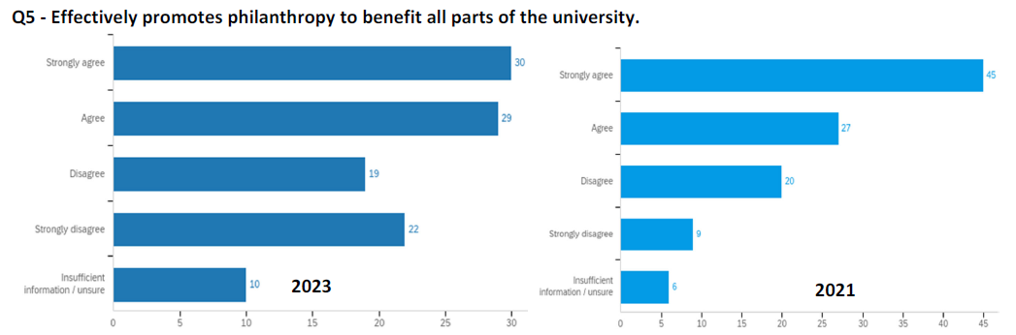
Administrative Review Committee
Chancellor Mo Dehghani – example positive
110 responses
107 responses

Slide 61
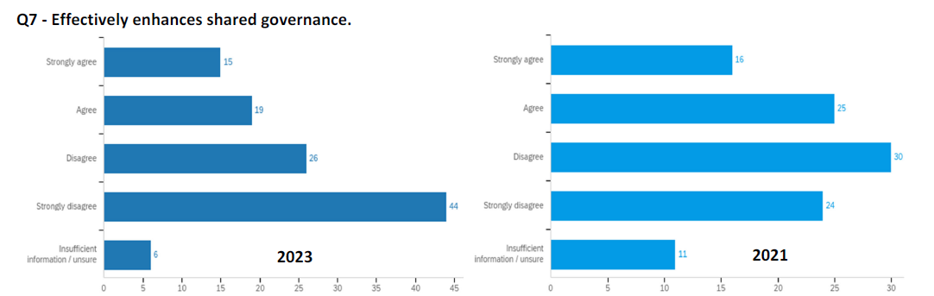
Administrative Review Committee
Chancellor Mo Dehghani – example negative
110 responses
106 responses

Slide 62
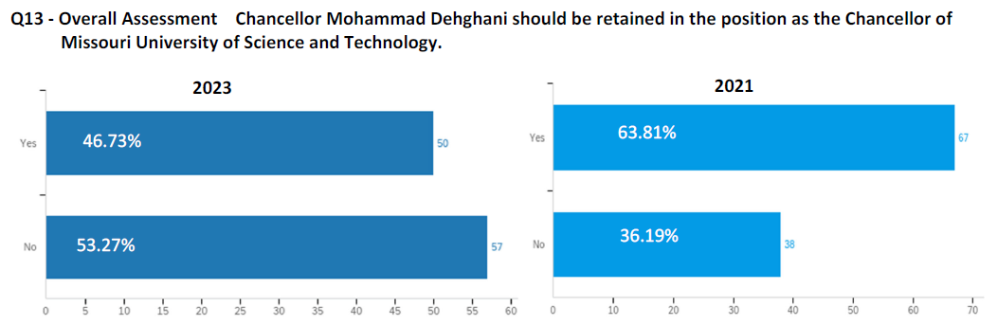
Administrative Review Committee
Chancellor Mo Dehghani - overall assessment
107 responses
105 responses

Slide 63
Chancellor Mo Dehghani (19 provided comments)
Strengths
Strong advocate to government and alumni
Energy and enthusiasm
Campus vision
Weaknesses
Micro-manages campus affairs that should be the responsibility of his direct reports
Does not appear to pay attention to data that counters his opinions
Not a proponent of shared governance, leading to friction with the faculty

Slide 64
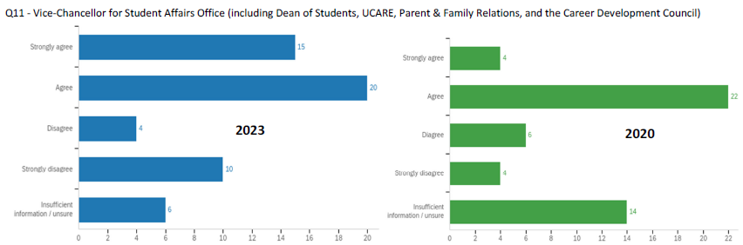
Administrative Review Committee
VC Student Affairs Debra Robinson – example positive
55 responses
50 responses
Note: responses were similar to this one.

Slide 65
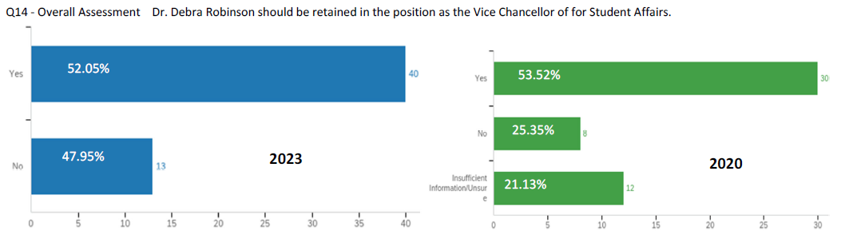
Administrative Review Committee
VC Student Affairs Debra Robinson – overall assessment
53 responses
50 responses

Slide 66
VC Student Affairs Robinson (21 provided comments)
Strengths
Tremendous asset to the university
Managed a strong COVID response team
Weaknesses
Needs to focus on quality of information and programming
Athletic programs need to be evaluated in light of campus goals

Slide 67
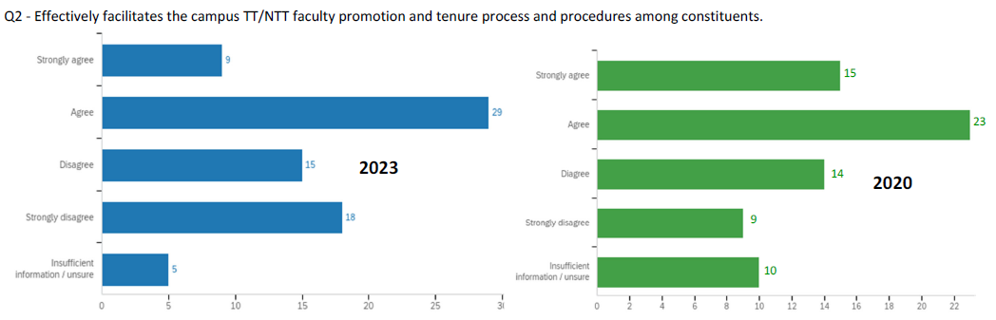
Administrative Review Committee
VP Faculty Affairs Daniel Forciniti – example positive
76 responses
71 responses

Slide 68
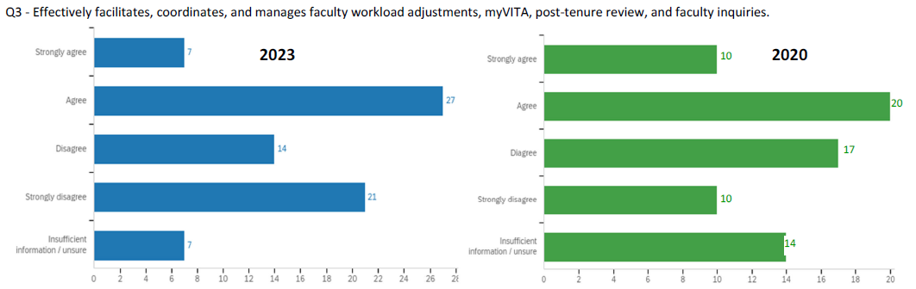
Administrative Review Committee
VP Faculty Affairs Daniel Forciniti – example negative
76 responses
71 responses

Slide 69
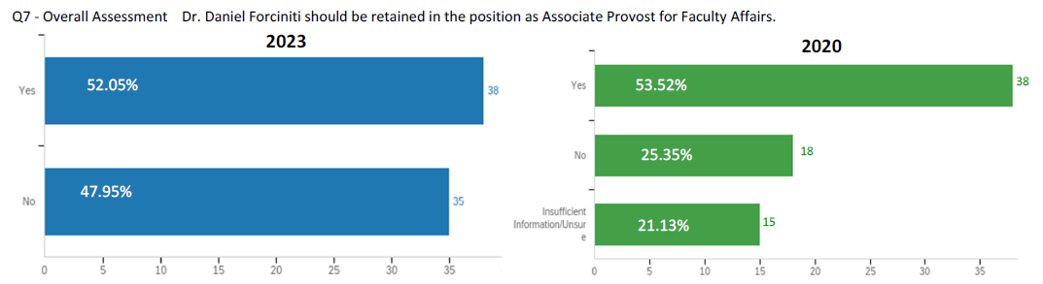
Administrative Review Committee
VP Faculty Affairs Daniel Forciniti – overall assessment
73 responses
71 responses

Slide 70
VP Faculty Affairs Forciniti (27 provided comments)
Strength
Collegial and kind
Weaknesses
Not strong in process
Needs to take more ownership in the Title IX process
Needs to take more ownership of MyVita

Slide 71
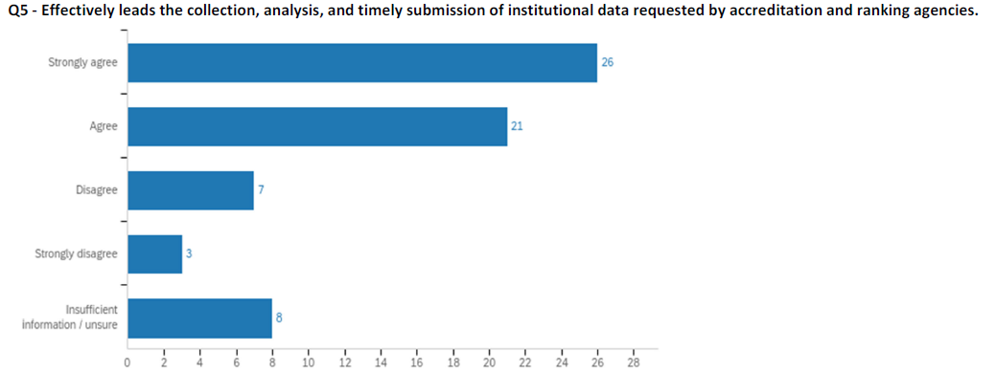
Administrative Review Committee
Chief Inst Research Officer Wayne Jones – example positive
65 responses
No comparisons
Note: responses were similar to this one.

Slide 72
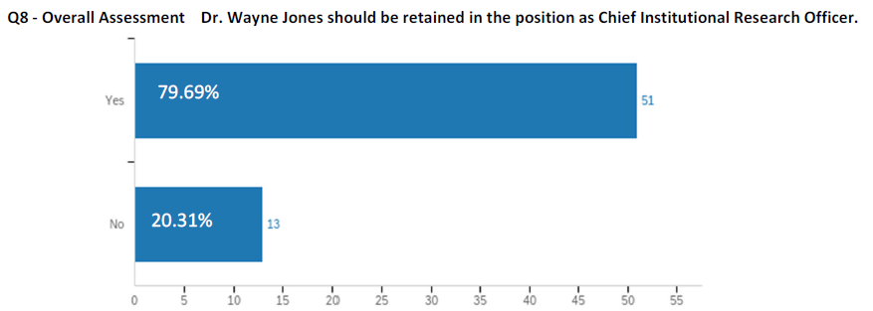
Administrative Review Committee
Chief Inst Research Officer Wayne Jones– overall
64 responses

Slide 73
Chief Inst Res Officer Jones (20 provided comments)
Strengths
Easy to work with
Responsive to request for information
Weakness
New to position

Slide 74
Agenda
VI. Reports of Standing Committees
F. ITCC
P. Koob

Slide 75
Agenda
VI. Reports of Standing Committees
G. Budgetary Affairs
M. Fitch

Slide 76
Budgetary Affairs Committee
March 23, 2023
Referrals
None
Continuing referrals:
Current and next FY budget
Report on the “big picture balance sheet”

Slide 77
Budget
Current FY budget
$1 million enrollment contingency gone (UG ↓, Grad↑, Distance ↓)
Next year (FY 2024)
State appropriation: 7.3% increase
Tuition:
  Enrollment projection: +63 freshman, -58 undergrads, +40 grad students; more form Illinois (nonresident tuition higher)
  Tuition model change to tiers, designed as net zero change, more students = +5.5%
Buildings:
  $25 MM from State for ERL, Schrenk, and extend geothermal to Parker, Norwood, and Harris, but delay to see if additional $25 MM next year for full cost

Slide 78
General Revenue Budget
 | FY 21 | FY 22 | FY 23 (budgeted) | FY 24 (budgeted)
Tuition and Fees | $119,477,148 | $119,255,572 | $123,885,664 | $130,720,817
Scholarship Allowance | (36,728,607) | (38,692,747) | (41,287,426) | (45,496,454)
Discount | 31% | 32% | 33.3% | 34.8%
Net Tuition & Fees | $83,748,541 | 80,562,825 | 82,598,238 | 85,224,364
State Appropriation | 45,690,941 | 53,026,096 | 55,942,347 | 60,120,535
Gift Revenues | 493,109 | 441,381 | 347,500 | 100,500
Recovery of F & A | 6,496,349 | 7,611,796 | 7,290,000 | 8,071,700
Endowment & Investment Income | 1,891,705 | 3,399,798 | 3,391,902 | 3,694,317
Sales & Services Income | 709,380 | 1,125,303 | 999,930 | 1,190,731
Other Incomes | 2,209,518 | 2,841,403 | 2,067,024 | 2,615,539
Revenue Contingency |  | - | - | -
Total Revenues | $140,239,544 | $149,008,602 | $152,636,941 | $161, 017,685
Enrollment: -58 UG, +40 grad
Discount rate up on
higher tuition
7.3% increase
FY 22 carryforward (FY 23)
3-3.5% over FY 23 actuals
Blank = covers $1 MM tuition shortfall
+8.38 million

Slide 79
General Revenue Budget: costs
Total Revenues | $140,239,544 | $149,008,602 | $152,636,941 | $161, 017,685
+$8.38 million
Transfers | FY 21 | FY 22 (actual*) | FY 23 (budgeted) | FY 24 (hallucinated)
Internal | $1,988,391 | ($1,097,298) | $1,470,667 | ($45,445)
Mandatory Transfers | (3,483,219) | (3,285,882) | (3,376,171) | (3,289,443)
NonMandatory Transfers | (7,114,077) | (4,445,964) | (3,850,000) | (4,767,215)
Total Transfers | ($8,630,105) | ($8,829,144) | ($5,755,504) | ($8,102,103)
Expenditures
Salaries & Wages | $75,195,068 | $72,970,747 | $80,441,613 | $82,662,837
Benefit Expense | 24,209,899 | 23,542,539 | 27,358,459 | 29,271,769
Compensation | $99,404,966 | $96,513,286 | $107,800,003 | $111,934,606
Other Expenses | 32,471,617 | 35,350,345 | 39,049,616 | 41,692,583
Total Expenditures | $131,876,584 | $131,863,631 | $146,849,689 | $153,627,192
 |  | Increase from previous year: | $14,986,058 | $6,777,503
Debt service
More buildings!
3% merit + 0.5% +1% market
But: Enrollment Mgt ↑,
Annual Giving reincarnation.
+2 IT and IT underpaid, + 2 HR
[2022 Inflation 6.5%]
[2023 Inflation 5%?]
Benefits 34% → 35.4% (=$200 ea)
Some increases:
Maintenance +362k
Utilities +261k
Insurance +65k

Slide 80
Overall FY 24 Budget
 | Operations | Other Unrestricted | Auxiliary Ops | Grants and Contracts | Gifts-Endow-RSA | Res Non-Gift Sch & Other | Current Funds | Endowment | Plant Funds | Loan Funds | University
Beginning Net Assets | 78,369,623 | 1,509,850 | 2,647,667 | 0 | 32,466,373 | 0 | 114,993,514 | 226,241,280 | 301,560,697 | 6,708,272 | 649,503,762
Revenues
Tuition and Fees | 130,720,817 | 609,285 | 2,176,000 | 0 | 0 | 0 | 133,506,102 | 0 | 0 | 0 | 133,506,102
Scholarship Allowance | (45,496,454) | (8,000) | (1,098,000) | (10,639,400) | (11,676,822) | (5,000,000) | (73,918,676) | 0 | 0 | 0 | (73,918,676)
Total Net Tuition and Fees | 85,224,364 | 601,285 | 1,078,000 | (10,639,400) | (11,676,822) | (5,000,000) | 59,587,426 | 0 | 0 | 0 | 59,587,426
State Appropriations | 60,120,535 | 0 | 0 | 0 | 0 | 0 | 60,120,535 | 0 | 3,261,693 | 0 | 63,382,228
Grants and Contracts | 0 | 0 | 0 | 64,600,000 | 2,075,000 | 5,000,000 | 71,675,000 | 0 | 8,000,000 | 0 | 79,675,000
Gifts | 100,500 | 0 | 0 | 0 | 19,898,035 | 0 | 19,998,535 | 2,520,043 | 26,693,742 | 0 | 49,212,320
Recovery of F&A | 8,071,700 | 0 | 0 | (8,071,700) | 0 | 0 | (0) | 0 | 0 | 0 | (0)
Endowment and Investments | 3,694,317 | 0 | 24,000 | 0 | 8,536,004 | 0 | 12,254,322 | (1,319,847) | 1,862,121 | 256,274 | 13,052,870
Sales and Services | 1,190,731 | 55,625 | 20,897,600 | 0 | 100 | 0 | 22,144,056 | 0 | 0 | 0 | 22,144,056
Other Income | 2,615,539 | 61,850 | 1,042,440 | 0 | 230,090 | 0 | 3,949,919 | 0 | 9,858 | (57,000) | 3,902,777
Total Revenues | 161,017,685 | 718,760 | 23,042,040 | 45,888,900 | 19,062,407 | 0 | 249,729,792 | 1,200,196 | 39,827,414 | 199,274 | 290,956,676
Transfers
Internal Transfers | (45,445) | 1,454,326 | (1,246,400) | 0 | (80,000) | 0 | 82,481 | 0 | 0 | 0 | 82,481
Mandatory Transfers | (3,289,443) | 0 | (7,190,127) | 127,000 | (500,000) | 0 | (10,852,570) | 500,000 | 10,352,570 | 0 | (0)
Non-Mandatory Transfers | (4,767,215) | 0 | (2,000,000) | (18,250,900) | (81,885) | 0 | (25,100,000) | 0 | 25,100,000 | 0 | 0
Total Transfers | (8,102,103) | 1,454,326 | (10,436,527) | (18,123,900) | (661,885) | 0 | (35,870,089) | 500,000 | 35,452,570 | 0 | 82,481
Expenditures
Salaries & Wages | 82,662,837 | 5,638,820 | 3,245,079 | 14,702,319 | 6,685,789 | 0 | 112,934,844 | 0 | 0 | 0 | 112,934,844
Benefit Expenses | 29,271,769 | 2,362,482 | 1,489,308 | 2,345,481 | 1,629,741 | 0 | 37,098,782 | 0 | 0 | 0 | 37,098,782
Total Compensation | 111,934,606 | 8,001,302 | 4,734,388 | 17,047,800 | 8,315,531 | 0 | 150,033,626 | 0 | 0 | 0 | 150,033,626
Other Expenses | 41,692,586 | (5,763,385) | 7,650,260 | 10,717,200 | 10,182,411 | 0 | 64,479,072 | 10,000 | 13,890,716 | 6,000 | 78,385,788
Total Expenditures | 153,627,192 | 2,237,917 | 12,384,648 | 27,765,000 | 18,497,942 | 0 | 214,512,698 | 10,000 | 13,890,716 | 6,000 | 228,419,414
Change in Net Assets | (711,610) | (64,831) | 220,865 | (0) | (97,420) | 0 | (652,995) | 1,690,196 | 61,389,268 | 193,274 | 62,619,743
Ending Net Assets | 77,658,013 | 1,445,020 | 2,868,533 | (0) | 32,368,953 | 0 | 114,340,519 | 227,931,476 | 362,949,965 | 6,901,547 | 712,123,506
‘Green’ money, $158 MM
Overall budget, $228 MM

Slide 81
Overall FY 24 Budget
Simplified explanations!
 | Operations | Other Unrestricted | Auxiliary Ops | Grants and Contracts | Gifts-Endow-RSA | Res Non-Gift Sch & Other | Current Funds | Endowment | Plant Funds | Loan Funds | University
Beginning Net Assets | 78,369,623 | 1,509,850 | 2,647,667 | 0 | 32,466,373 | 0 | 114,993,514 | 226,241,280 | 301,560,697 | 6,708,272 | 649,503,762
Revenues
Tuition and Fees | 130,720,817 | 609,285 | 2,176,000 | 0 | 0 | 0 | 133,506,102 | 0 | 0 | 0 | 133,506,102
Scholarship Allowance | (45,496,454) | (8,000) | (1,098,000) | (10,639,400) | (11,676,822) | (5,000,000) | (73,918,676) | 0 | 0 | 0 | (73,918,676)
Total Net Tuition and Fees | 85,224,364 | 601,285 | 1,078,000 | (10,639,400) | (11,676,822) | (5,000,000) | 59,587,426 | 0 | 0 | 0 | 59,587,426
State Appropriations | 60,120,535 | 0 | 0 | 0 | 0 | 0 | 60,120,535 | 0 | 3,261,693 | 0 | 63,382,228
Grants and Contracts | 0 | 0 | 0 | 64,600,000 | 2,075,000 | 5,000,000 | 71,675,000 | 0 | 8,000,000 | 0 | 79,675,000
Gifts | 100,500 | 0 | 0 | 0 | 19,898,035 | 0 | 19,998,535 | 2,520,043 | 26,693,742 | 0 | 49,212,320
Recovery of F&A | 8,071,700 | 0 | 0 | (8,071,700) | 0 | 0 | (0) | 0 | 0 | 0 | (0)
Endowment and Investments | 3,694,317 | 0 | 24,000 | 0 | 8,536,004 | 0 | 12,254,322 | (1,319,847) | 1,862,121 | 256,274 | 13,052,870
Sales and Services | 1,190,731 | 55,625 | 20,897,600 | 0 | 100 | 0 | 22,144,056 | 0 | 0 | 0 | 22,144,056
Other Income | 2,615,539 | 61,850 | 1,042,440 | 0 | 230,090 | 0 | 3,949,919 | 0 | 9,858 | (57,000) | 3,902,777
Total Revenues | 161,017,685 | 718,760 | 23,042,040 | 45,888,900 | 19,062,407 | 0 | 249,729,792 | 1,200,196 | 39,827,414 | 199,274 | 290,956,676
Transfers
Internal Transfers | (45,445) | 1,454,326 | (1,246,400) | 0 | (80,000) | 0 | 82,481 | 0 | 0 | 0 | 82,481
Mandatory Transfers | (3,289,443) | 0 | (7,190,127) | 127,000 | (500,000) | 0 | (10,852,570) | 500,000 | 10,352,570 | 0 | (0)
Non-Mandatory Transfers | (4,767,215) | 0 | (2,000,000) | (18,250,900) | (81,885) | 0 | (25,100,000) | 0 | 25,100,000 | 0 | 0
Total Transfers | (8,102,103) | 1,454,326 | (10,436,527) | (18,123,900) | (661,885) | 0 | (35,870,089) | 500,000 | 35,452,570 | 0 | 82,481
Expenditures
Salaries & Wages | 82,662,837 | 5,638,820 | 3,245,079 | 14,702,319 | 6,685,789 | 0 | 112,934,844 | 0 | 0 | 0 | 112,934,844
Benefit Expenses | 29,271,769 | 2,362,482 | 1,489,308 | 2,345,481 | 1,629,741 | 0 | 37,098,782 | 0 | 0 | 0 | 37,098,782
Total Compensation | 111,934,606 | 8,001,302 | 4,734,388 | 17,047,800 | 8,315,531 | 0 | 150,033,626 | 0 | 0 | 0 | 150,033,626
Other Expenses | 41,692,586 | (5,763,385) | 7,650,260 | 10,717,200 | 10,182,411 | 0 | 64,479,072 | 10,000 | 13,890,716 | 6,000 | 78,385,788
Total Expenditures | 153,627,192 | 2,237,917 | 12,384,648 | 27,765,000 | 18,497,942 | 0 | 214,512,698 | 10,000 | 13,890,716 | 6,000 | 228,419,414
Change in Net Assets | (711,610) | (64,831) | 220,865 | (0) | (97,420) | 0 | (652,995) | 1,690,196 | 61,389,268 | 193,274 | 62,619,743
Ending Net Assets | 77,658,013 | 1,445,020 | 2,868,533 | (0) | 32,368,953 | 0 | 114,340,519 | 227,931,476 | 362,949,965 | 6,901,547 | 712,123,506
Pell, e.g.
~29% on 27.7 MM ‘Direct’
Buildings
“Direct”
: GRA, summer
: supplies, etc.

Slide 82
Overall FY 24 Budget
Simplified explanations!
Dorms,
Food
 | Operations | Other Unrestricted | Auxiliary Ops | Grants and Contracts | Gifts-Endow-RSA | Res Non-Gift Sch & Other | Current Funds | Endowment | Plant Funds | Loan Funds | University
Beginning Net Assets | 78,369,623 | 1,509,850 | 2,647,667 | 0 | 32,466,373 | 0 | 114,993,514 | 226,241,280 | 301,560,697 | 6,708,272 | 649,503,762
Revenues
Tuition and Fees | 130,720,817 | 609,285 | 2,176,000 | 0 | 0 | 0 | 133,506,102 | 0 | 0 | 0 | 133,506,102
Scholarship Allowance | (45,496,454) | (8,000) | (1,098,000) | (10,639,400) | (11,676,822) | (5,000,000) | (73,918,676) | 0 | 0 | 0 | (73,918,676)
Total Net Tuition and Fees | 85,224,364 | 601,285 | 1,078,000 | (10,639,400) | (11,676,822) | (5,000,000) | 59,587,426 | 0 | 0 | 0 | 59,587,426
State Appropriations | 60,120,535 | 0 | 0 | 0 | 0 | 0 | 60,120,535 | 0 | 3,261,693 | 0 | 63,382,228
Grants and Contracts | 0 | 0 | 0 | 64,600,000 | 2,075,000 | 5,000,000 | 71,675,000 | 0 | 8,000,000 | 0 | 79,675,000
Gifts | 100,500 | 0 | 0 | 0 | 19,898,035 | 0 | 19,998,535 | 2,520,043 | 26,693,742 | 0 | 49,212,320
Recovery of F&A | 8,071,700 | 0 | 0 | (8,071,700) | 0 | 0 | (0) | 0 | 0 | 0 | (0)
Endowment and Investments | 3,694,317 | 0 | 24,000 | 0 | 8,536,004 | 0 | 12,254,322 | (1,319,847) | 1,862,121 | 256,274 | 13,052,870
Sales and Services | 1,190,731 | 55,625 | 20,897,600 | 0 | 100 | 0 | 22,144,056 | 0 | 0 | 0 | 22,144,056
Other Income | 2,615,539 | 61,850 | 1,042,440 | 0 | 230,090 | 0 | 3,949,919 | 0 | 9,858 | (57,000) | 3,902,777
Total Revenues | 161,017,685 | 718,760 | 23,042,040 | 45,888,900 | 19,062,407 | 0 | 249,729,792 | 1,200,196 | 39,827,414 | 199,274 | 290,956,676
Transfers
Internal Transfers | (45,445) | 1,454,326 | (1,246,400) | 0 | (80,000) | 0 | 82,481 | 0 | 0 | 0 | 82,481
Mandatory Transfers | (3,289,443) | 0 | (7,190,127) | 127,000 | (500,000) | 0 | (10,852,570) | 500,000 | 10,352,570 | 0 | (0)
Non-Mandatory Transfers | (4,767,215) | 0 | (2,000,000) | (18,250,900) | (81,885) | 0 | (25,100,000) | 0 | 25,100,000 | 0 | 0
Total Transfers | (8,102,103) | 1,454,326 | (10,436,527) | (18,123,900) | (661,885) | 0 | (35,870,089) | 500,000 | 35,452,570 | 0 | 82,481
Expenditures
Salaries & Wages | 82,662,837 | 5,638,820 | 3,245,079 | 14,702,319 | 6,685,789 | 0 | 112,934,844 | 0 | 0 | 0 | 112,934,844
Benefit Expenses | 29,271,769 | 2,362,482 | 1,489,308 | 2,345,481 | 1,629,741 | 0 | 37,098,782 | 0 | 0 | 0 | 37,098,782
Total Compensation | 111,934,606 | 8,001,302 | 4,734,388 | 17,047,800 | 8,315,531 | 0 | 150,033,626 | 0 | 0 | 0 | 150,033,626
Other Expenses | 41,692,586 | (5,763,385) | 7,650,260 | 10,717,200 | 10,182,411 | 0 | 64,479,072 | 10,000 | 13,890,716 | 6,000 | 78,385,788
Total Expenditures | 153,627,192 | 2,237,917 | 12,384,648 | 27,765,000 | 18,497,942 | 0 | 214,512,698 | 10,000 | 13,890,716 | 6,000 | 228,419,414
Change in Net Assets | (711,610) | (64,831) | 220,865 | (0) | (97,420) | 0 | (652,995) | 1,690,196 | 61,389,268 | 193,274 | 62,619,743
Ending Net Assets | 77,658,013 | 1,445,020 | 2,868,533 | (0) | 32,368,953 | 0 | 114,340,519 | 227,931,476 | 362,949,965 | 6,901,547 | 712,123,506
Bond payments
Facilities staff at Res Halls,
Other staff for Res Halls
: Res Hall staff, etc.

Slide 83
Overall FY 24 Budget
Simplified explanations!
 | Operations | Other Unrestricted | Auxiliary Ops | Grants and Contracts | Gifts-Endow-RSA | Res Non-Gift Sch & Other | Current Funds | Endowment | Plant Funds | Loan Funds | University
Beginning Net Assets | 78,369,623 | 1,509,850 | 2,647,667 | 0 | 32,466,373 | 0 | 114,993,514 | 226,241,280 | 301,560,697 | 6,708,272 | 649,503,762
Revenues
Tuition and Fees | 130,720,817 | 609,285 | 2,176,000 | 0 | 0 | 0 | 133,506,102 | 0 | 0 | 0 | 133,506,102
Scholarship Allowance | (45,496,454) | (8,000) | (1,098,000) | (10,639,400) | (11,676,822) | (5,000,000) | (73,918,676) | 0 | 0 | 0 | (73,918,676)
Total Net Tuition and Fees | 85,224,364 | 601,285 | 1,078,000 | (10,639,400) | (11,676,822) | (5,000,000) | 59,587,426 | 0 | 0 | 0 | 59,587,426
State Appropriations | 60,120,535 | 0 | 0 | 0 | 0 | 0 | 60,120,535 | 0 | 3,261,693 | 0 | 63,382,228
Grants and Contracts | 0 | 0 | 0 | 64,600,000 | 2,075,000 | 5,000,000 | 71,675,000 | 0 | 8,000,000 | 0 | 79,675,000
Gifts | 100,500 | 0 | 0 | 0 | 19,898,035 | 0 | 19,998,535 | 2,520,043 | 26,693,742 | 0 | 49,212,320
Recovery of F&A | 8,071,700 | 0 | 0 | (8,071,700) | 0 | 0 | (0) | 0 | 0 | 0 | (0)
Endowment and Investments | 3,694,317 | 0 | 24,000 | 0 | 8,536,004 | 0 | 12,254,322 | (1,319,847) | 1,862,121 | 256,274 | 13,052,870
Sales and Services | 1,190,731 | 55,625 | 20,897,600 | 0 | 100 | 0 | 22,144,056 | 0 | 0 | 0 | 22,144,056
Other Income | 2,615,539 | 61,850 | 1,042,440 | 0 | 230,090 | 0 | 3,949,919 | 0 | 9,858 | (57,000) | 3,902,777
Total Revenues | 161,017,685 | 718,760 | 23,042,040 | 45,888,900 | 19,062,407 | 0 | 249,729,792 | 1,200,196 | 39,827,414 | 199,274 | 290,956,676
Transfers
Internal Transfers | (45,445) | 1,454,326 | (1,246,400) | 0 | (80,000) | 0 | 82,481 | 0 | 0 | 0 | 82,481
Mandatory Transfers | (3,289,443) | 0 | (7,190,127) | 127,000 | (500,000) | 0 | (10,852,570) | 500,000 | 10,352,570 | 0 | (0)
Non-Mandatory Transfers | (4,767,215) | 0 | (2,000,000) | (18,250,900) | (81,885) | 0 | (25,100,000) | 0 | 25,100,000 | 0 | 0
Total Transfers | (8,102,103) | 1,454,326 | (10,436,527) | (18,123,900) | (661,885) | 0 | (35,870,089) | 500,000 | 35,452,570 | 0 | 82,481
Expenditures
Salaries & Wages | 82,662,837 | 5,638,820 | 3,245,079 | 14,702,319 | 6,685,789 | 0 | 112,934,844 | 0 | 0 | 0 | 112,934,844
Benefit Expenses | 29,271,769 | 2,362,482 | 1,489,308 | 2,345,481 | 1,629,741 | 0 | 37,098,782 | 0 | 0 | 0 | 37,098,782
Total Compensation | 111,934,606 | 8,001,302 | 4,734,388 | 17,047,800 | 8,315,531 | 0 | 150,033,626 | 0 | 0 | 0 | 150,033,626
Other Expenses | 41,692,586 | (5,763,385) | 7,650,260 | 10,717,200 | 10,182,411 | 0 | 64,479,072 | 10,000 | 13,890,716 | 6,000 | 78,385,788
Total Expenditures | 153,627,192 | 2,237,917 | 12,384,648 | 27,765,000 | 18,497,942 | 0 | 214,512,698 | 10,000 | 13,890,716 | 6,000 | 228,419,414
Change in Net Assets | (711,610) | (64,831) | 220,865 | (0) | (97,420) | 0 | (652,995) | 1,690,196 | 61,389,268 | 193,274 | 62,619,743
Ending Net Assets | 77,658,013 | 1,445,020 | 2,868,533 | (0) | 32,368,953 | 0 | 114,340,519 | 227,931,476 | 362,949,965 | 6,901,547 | 712,123,506
~4.5% yield
Endowed scholarships + KI
Gifts Endowing ….
: KI funded positions + endowed
: KI funded expenses $6.3 MM,
+ Donor-directed (e.g Dep’t-level funds)

Slide 84
Overall FY 24 Budget
Simplified explanations!
Overall
budget
 | Operations | Other Unrestricted | Auxiliary Ops | Grants and Contracts | Gifts-Endow-RSA | Res Non-Gift Sch & Other | Current Funds | Endowment | Plant Funds | Loan Funds | University
Beginning Net Assets | 78,369,623 | 1,509,850 | 2,647,667 | 0 | 32,466,373 | 0 | 114,993,514 | 226,241,280 | 301,560,697 | 6,708,272 | 649,503,762
Revenues
Tuition and Fees | 130,720,817 | 609,285 | 2,176,000 | 0 | 0 | 0 | 133,506,102 | 0 | 0 | 0 | 133,506,102
Scholarship Allowance | (45,496,454) | (8,000) | (1,098,000) | (10,639,400) | (11,676,822) | (5,000,000) | (73,918,676) | 0 | 0 | 0 | (73,918,676)
Total Net Tuition and Fees | 85,224,364 | 601,285 | 1,078,000 | (10,639,400) | (11,676,822) | (5,000,000) | 59,587,426 | 0 | 0 | 0 | 59,587,426
State Appropriations | 60,120,535 | 0 | 0 | 0 | 0 | 0 | 60,120,535 | 0 | 3,261,693 | 0 | 63,382,228
Grants and Contracts | 0 | 0 | 0 | 64,600,000 | 2,075,000 | 5,000,000 | 71,675,000 | 0 | 8,000,000 | 0 | 79,675,000
Gifts | 100,500 | 0 | 0 | 0 | 19,898,035 | 0 | 19,998,535 | 2,520,043 | 26,693,742 | 0 | 49,212,320
Recovery of F&A | 8,071,700 | 0 | 0 | (8,071,700) | 0 | 0 | (0) | 0 | 0 | 0 | (0)
Endowment and Investments | 3,694,317 | 0 | 24,000 | 0 | 8,536,004 | 0 | 12,254,322 | (1,319,847) | 1,862,121 | 256,274 | 13,052,870
Sales and Services | 1,190,731 | 55,625 | 20,897,600 | 0 | 100 | 0 | 22,144,056 | 0 | 0 | 0 | 22,144,056
Other Income | 2,615,539 | 61,850 | 1,042,440 | 0 | 230,090 | 0 | 3,949,919 | 0 | 9,858 | (57,000) | 3,902,777
Total Revenues | 161,017,685 | 718,760 | 23,042,040 | 45,888,900 | 19,062,407 | 0 | 249,729,792 | 1,200,196 | 39,827,414 | 199,274 | 290,956,676
Transfers
Internal Transfers | (45,445) | 1,454,326 | (1,246,400) | 0 | (80,000) | 0 | 82,481 | 0 | 0 | 0 | 82,481
Mandatory Transfers | (3,289,443) | 0 | (7,190,127) | 127,000 | (500,000) | 0 | (10,852,570) | 500,000 | 10,352,570 | 0 | (0)
Non-Mandatory Transfers | (4,767,215) | 0 | (2,000,000) | (18,250,900) | (81,885) | 0 | (25,100,000) | 0 | 25,100,000 | 0 | 0
Total Transfers | (8,102,103) | 1,454,326 | (10,436,527) | (18,123,900) | (661,885) | 0 | (35,870,089) | 500,000 | 35,452,570 | 0 | 82,481
Expenditures
Salaries & Wages | 82,662,837 | 5,638,820 | 3,245,079 | 14,702,319 | 6,685,789 | 0 | 112,934,844 | 0 | 0 | 0 | 112,934,844
Benefit Expenses | 29,271,769 | 2,362,482 | 1,489,308 | 2,345,481 | 1,629,741 | 0 | 37,098,782 | 0 | 0 | 0 | 37,098,782
Total Compensation | 111,934,606 | 8,001,302 | 4,734,388 | 17,047,800 | 8,315,531 | 0 | 150,033,626 | 0 | 0 | 0 | 150,033,626
Other Expenses | 41,692,586 | (5,763,385) | 7,650,260 | 10,717,200 | 10,182,411 | 0 | 64,479,072 | 10,000 | 13,890,716 | 6,000 | 78,385,788
Total Expenditures | 153,627,192 | 2,237,917 | 12,384,648 | 27,765,000 | 18,497,942 | 0 | 214,512,698 | 10,000 | 13,890,716 | 6,000 | 228,419,414
Change in Net Assets | (711,610) | (64,831) | 220,865 | (0) | (97,420) | 0 | (652,995) | 1,690,196 | 61,389,268 | 193,274 | 62,619,743
Ending Net Assets | 77,658,013 | 1,445,020 | 2,868,533 | (0) | 32,368,953 | 0 | 114,340,519 | 227,931,476 | 362,949,965 | 6,901,547 | 712,123,506
Institutions should have $ on account

Slide 85
Overall FY 24 Budget
Simplified explanations!
Buildings
 | Operations | Other Unrestricted | Auxiliary Ops | Grants and Contracts | Gifts-Endow-RSA | Res Non-Gift Sch & Other | Current Funds | Endowment | Plant Funds | Loan Funds | University
Beginning Net Assets | 78,369,623 | 1,509,850 | 2,647,667 | 0 | 32,466,373 | 0 | 114,993,514 | 226,241,280 | 301,560,697 | 6,708,272 | 649,503,762
Revenues
Tuition and Fees | 130,720,817 | 609,285 | 2,176,000 | 0 | 0 | 0 | 133,506,102 | 0 | 0 | 0 | 133,506,102
Scholarship Allowance | (45,496,454) | (8,000) | (1,098,000) | (10,639,400) | (11,676,822) | (5,000,000) | (73,918,676) | 0 | 0 | 0 | (73,918,676)
Total Net Tuition and Fees | 85,224,364 | 601,285 | 1,078,000 | (10,639,400) | (11,676,822) | (5,000,000) | 59,587,426 | 0 | 0 | 0 | 59,587,426
State Appropriations | 60,120,535 | 0 | 0 | 0 | 0 | 0 | 60,120,535 | 0 | 3,261,693 | 0 | 63,382,228
Grants and Contracts | 0 | 0 | 0 | 64,600,000 | 2,075,000 | 5,000,000 | 71,675,000 | 0 | 8,000,000 | 0 | 79,675,000
Gifts | 100,500 | 0 | 0 | 0 | 19,898,035 | 0 | 19,998,535 | 2,520,043 | 26,693,742 | 0 | 49,212,320
Recovery of F&A | 8,071,700 | 0 | 0 | (8,071,700) | 0 | 0 | (0) | 0 | 0 | 0 | (0)
Endowment and Investments | 3,694,317 | 0 | 24,000 | 0 | 8,536,004 | 0 | 12,254,322 | (1,319,847) | 1,862,121 | 256,274 | 13,052,870
Sales and Services | 1,190,731 | 55,625 | 20,897,600 | 0 | 100 | 0 | 22,144,056 | 0 | 0 | 0 | 22,144,056
Other Income | 2,615,539 | 61,850 | 1,042,440 | 0 | 230,090 | 0 | 3,949,919 | 0 | 9,858 | (57,000) | 3,902,777
Total Revenues | 161,017,685 | 718,760 | 23,042,040 | 45,888,900 | 19,062,407 | 0 | 249,729,792 | 1,200,196 | 39,827,414 | 199,274 | 290,956,676
Transfers
Internal Transfers | (45,445) | 1,454,326 | (1,246,400) | 0 | (80,000) | 0 | 82,481 | 0 | 0 | 0 | 82,481
Mandatory Transfers | (3,289,443) | 0 | (7,190,127) | 127,000 | (500,000) | 0 | (10,852,570) | 500,000 | 10,352,570 | 0 | (0)
Non-Mandatory Transfers | (4,767,215) | 0 | (2,000,000) | (18,250,900) | (81,885) | 0 | (25,100,000) | 0 | 25,100,000 | 0 | 0
Total Transfers | (8,102,103) | 1,454,326 | (10,436,527) | (18,123,900) | (661,885) | 0 | (35,870,089) | 500,000 | 35,452,570 | 0 | 82,481
Expenditures
Salaries & Wages | 82,662,837 | 5,638,820 | 3,245,079 | 14,702,319 | 6,685,789 | 0 | 112,934,844 | 0 | 0 | 0 | 112,934,844
Benefit Expenses | 29,271,769 | 2,362,482 | 1,489,308 | 2,345,481 | 1,629,741 | 0 | 37,098,782 | 0 | 0 | 0 | 37,098,782
Total Compensation | 111,934,606 | 8,001,302 | 4,734,388 | 17,047,800 | 8,315,531 | 0 | 150,033,626 | 0 | 0 | 0 | 150,033,626
Other Expenses | 41,692,586 | (5,763,385) | 7,650,260 | 10,717,200 | 10,182,411 | 0 | 64,479,072 | 10,000 | 13,890,716 | 6,000 | 78,385,788
Total Expenditures | 153,627,192 | 2,237,917 | 12,384,648 | 27,765,000 | 18,497,942 | 0 | 214,512,698 | 10,000 | 13,890,716 | 6,000 | 228,419,414
Change in Net Assets | (711,610) | (64,831) | 220,865 | (0) | (97,420) | 0 | (652,995) | 1,690,196 | 61,389,268 | 193,274 | 62,619,743
Ending Net Assets | 77,658,013 | 1,445,020 | 2,868,533 | (0) | 32,368,953 | 0 | 114,340,519 | 227,931,476 | 362,949,965 | 6,901,547 | 712,123,506
Estimated value of buildings
New construction + maintenance costs
New construction + maintenance costs
$24 MM depreciation
+4.8 MM interest on debt
+1.1 MM non-capital & M&R
-17 MM capital expenses

Slide 86
Agenda
VII. Adjourn
86

